Slide 1
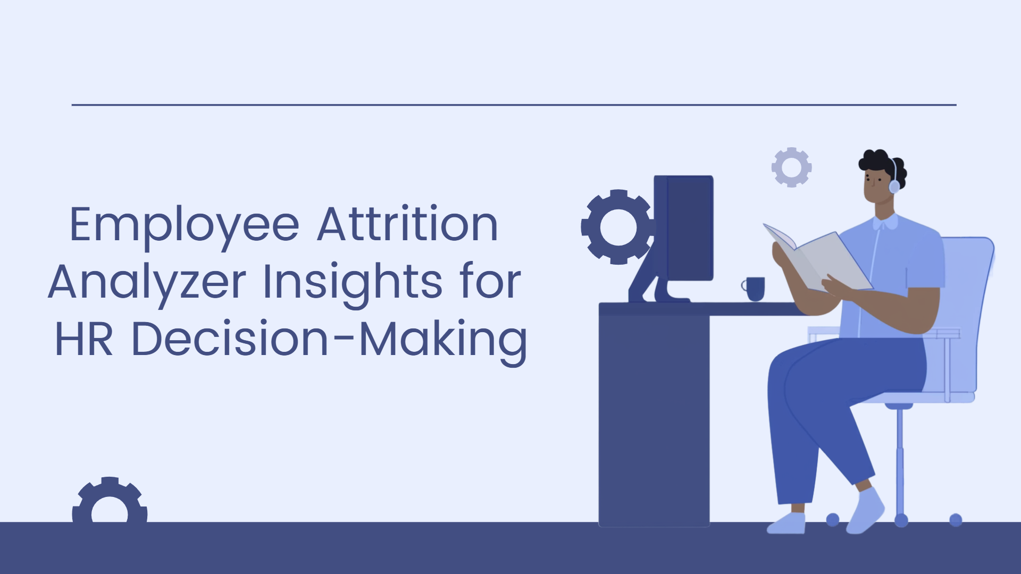

Slide 2
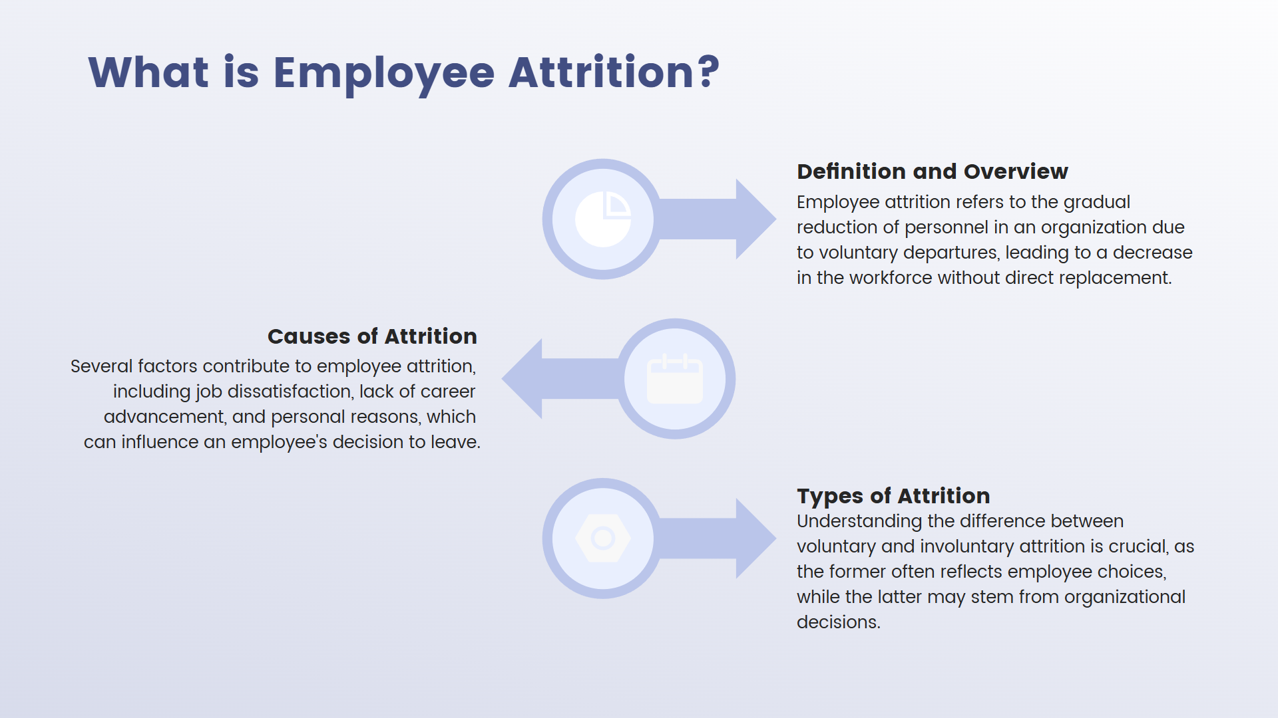

Slide 3
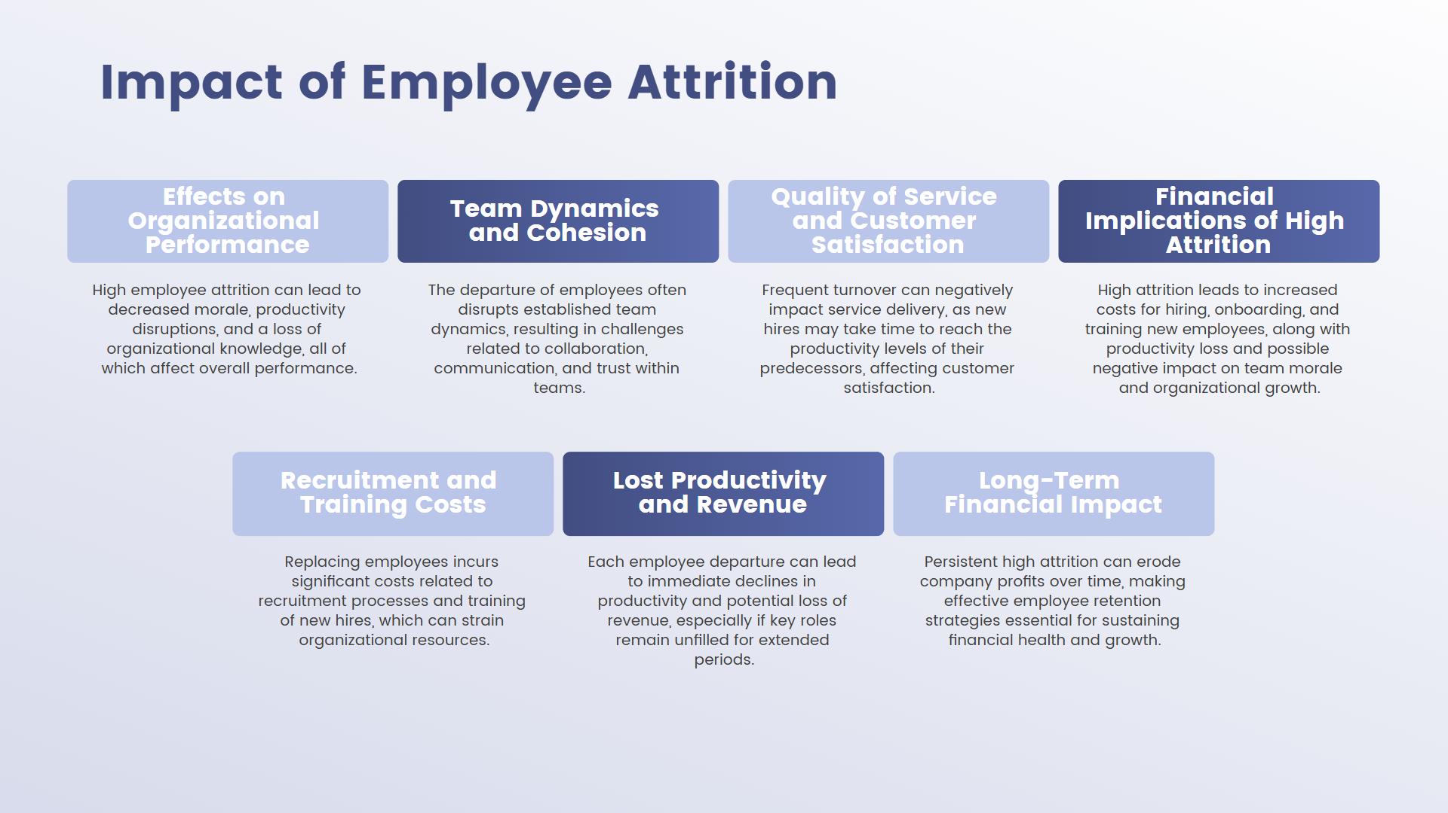

Slide 4
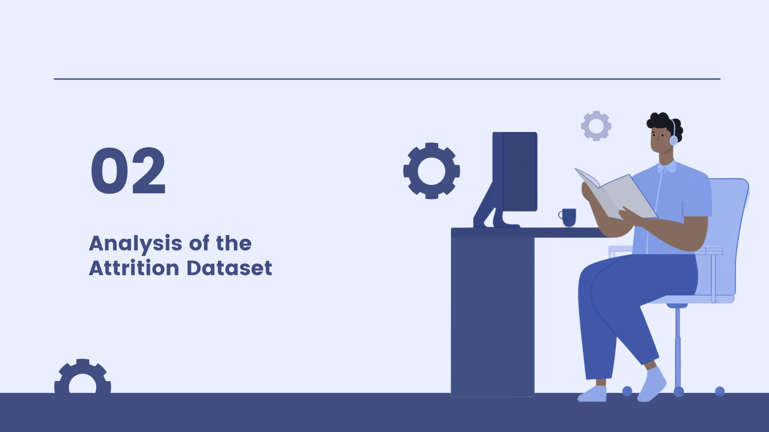

Slide 5

PREDICTING EMPLOYEE ATTRITION THROUGH HR ANALYTICS
This study focuses on HR analytics as a systematic approach to understanding how people-related data impacts business outcomes, especially in predicting employee attrition. With the rise in remote work and employee resignations, organizations face new challenges in managing and retaining talent. To address this, the study explores various supervised machine learning models—such as Random Forest, Decision Tree, K-Nearest Neighbors, Support Vector Machines, Logistic Regression, and Extreme Gradient Boosting—to forecast employee turnover. The findings highlight Random Forest's strength in handling complex patterns, Decision Tree's simplicity and interpretability, and the efficiency of other models in identifying attrition risks. Overall, HR analytics powered by AI is shown to be a valuable tool in strategic workforce planning.

Slide 6
Employee Attrition: Analysis of Data Driven Models
This project applies data analytics and visualization techniques to predict employee attrition using the IBM HR Analytics dataset. Various machine learning models—including Logistic Regression, KNN, Decision Tree, and Naïve Bayes—along with ensemble methods like Random Forest, AdaBoost, and XGBoost were evaluated. Two deep learning models, Feedforward Neural Network (FNN) and CNN, were also implemented. Visualizations were used to explore key factors influencing attrition, such as job satisfaction and overtime. Among all models, FNN delivered the best performance with 97.5% accuracy. The project highlights how analytical modeling and data visualization together can provide meaningful insights to HR, helping identify at-risk employees and enabling proactive retention strategies.
https://pdfs.semanticscholar.org/45f0/d69063f568b0e55008911057af092d111a30.pdf

Slide 7
Analysis and classification of employee attrition and absenteeism in industry
This research introduces a novel SPM-based methodology called E(3A)CSPM to analyze and predict employee attrition and absenteeism—two key issues that negatively impact productivity and cost. The method uses Sequential Pattern Mining (SPM) to uncover patterns from four public employee datasets. These patterns reveal key features and their values associated with attrition and absenteeism. The extracted sequential rules are then used for classification using eight different machine learning models. Results show that E(3A)CSPM outperforms existing state-of-the-art methods, demonstrating high accuracy and generalizability for talent management and early intervention.
https://www.sciencedirect.com/science/article/abs/pii/S0166361524000344

Slide 8
DATASET:
https://www.kaggle.com/code/sivashankar99/hr-analytics?scriptVersionId=181898458&cellId=4

Slide 9
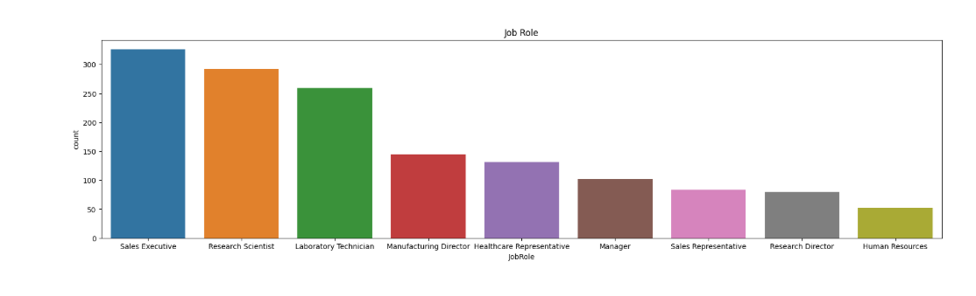
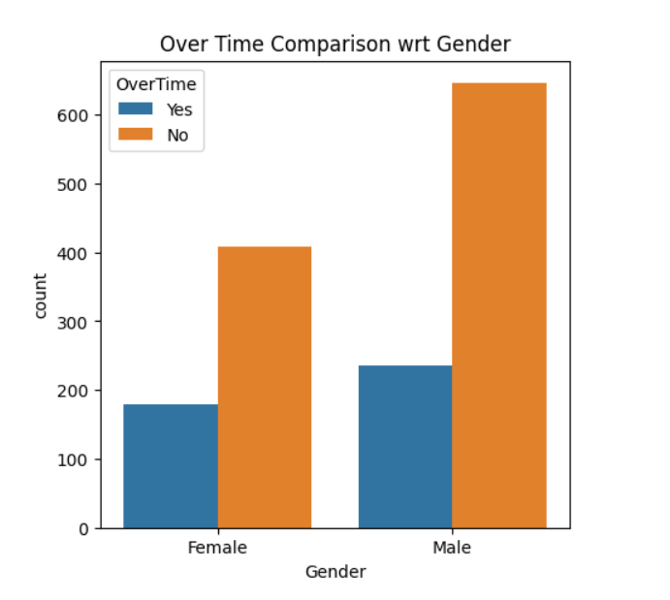

Slide 10
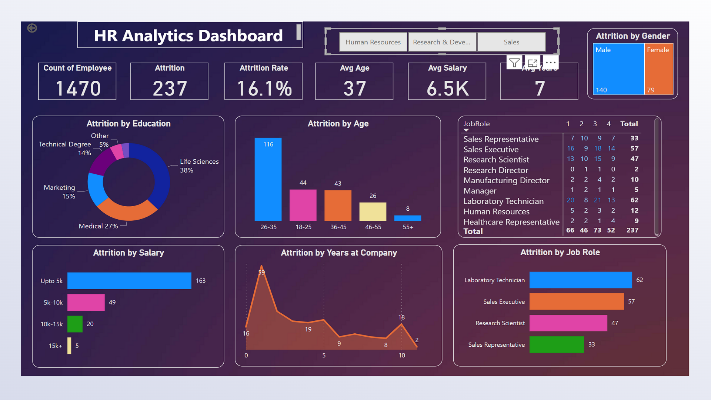

Slide 11
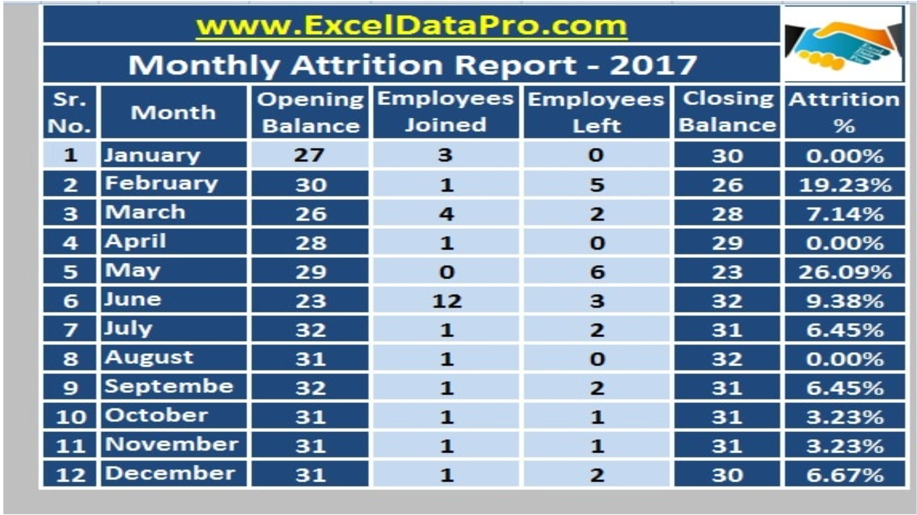

Slide 12


